Slide 1

Kishkinda. university
Bellary.

Slide 2
ATHLETE SPONSORSHIP MANAGER.
PRESENTED BY:
Sl.no Name USN
1. SHIVAKUMAR.B.V. KUB23CSE133
2. MARITEMAPPA.S.K. KUB23CSE081
3. PRAJWAL.B. KUB23CSE104
4. BASAVARAJ.K.S. KUB23CSE023
5. PRASANNA.B KUB23CSE105

Slide 3
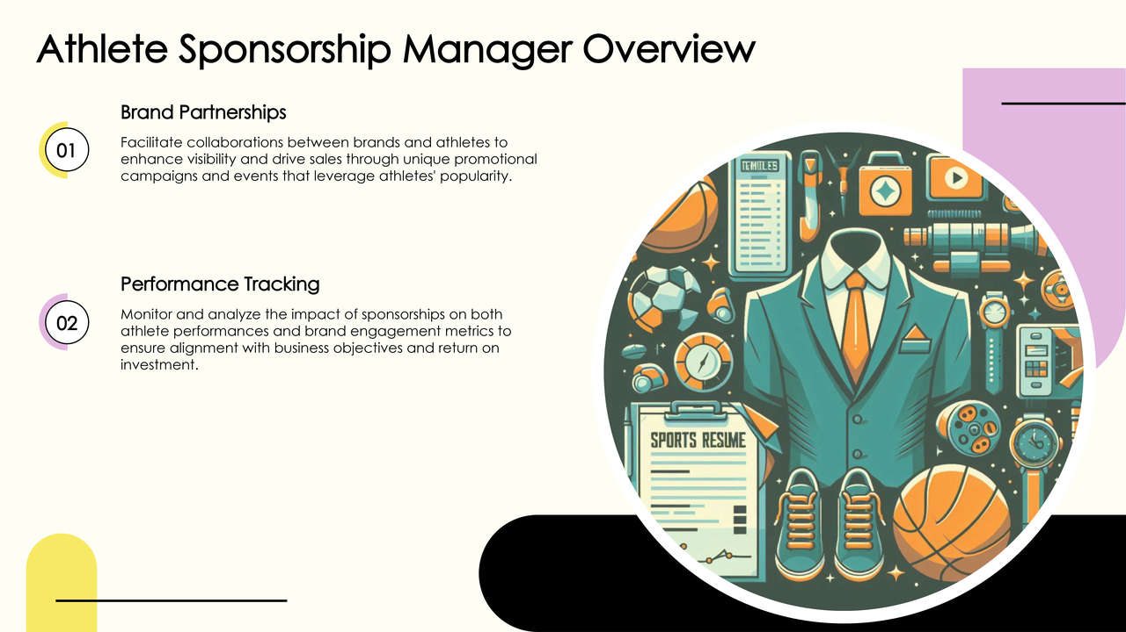

Slide 4
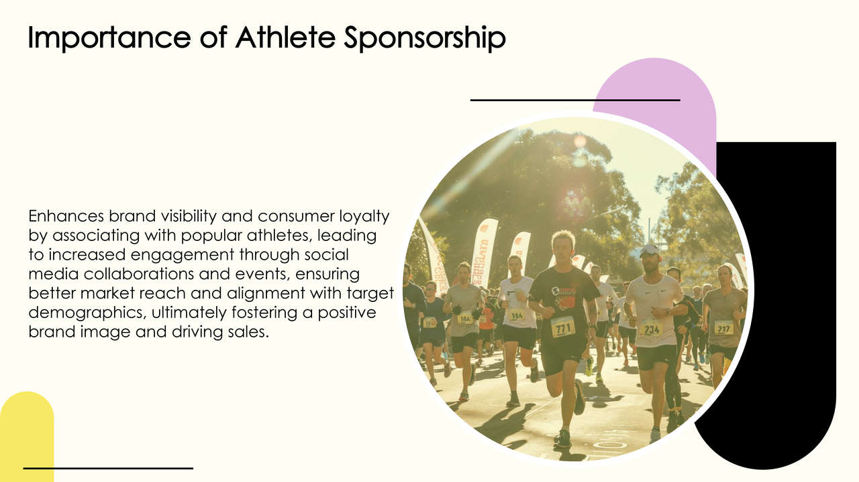

Slide 5
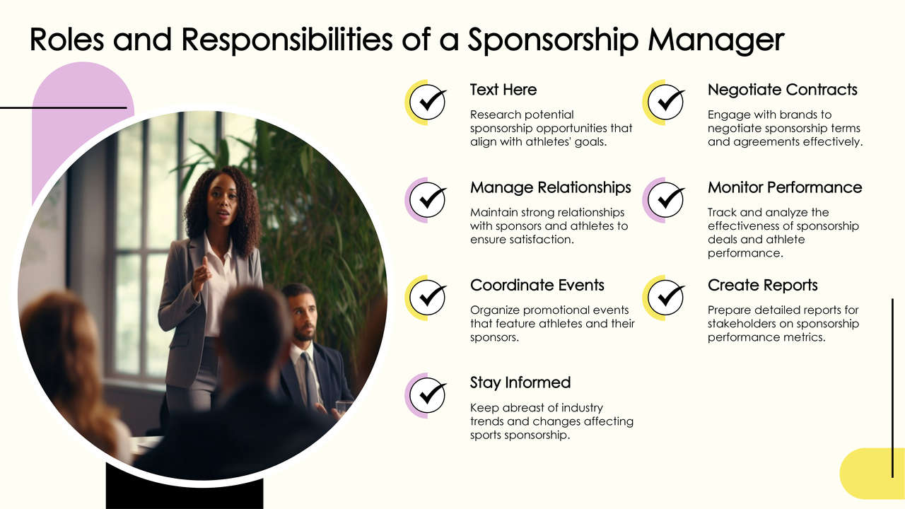

Slide 6
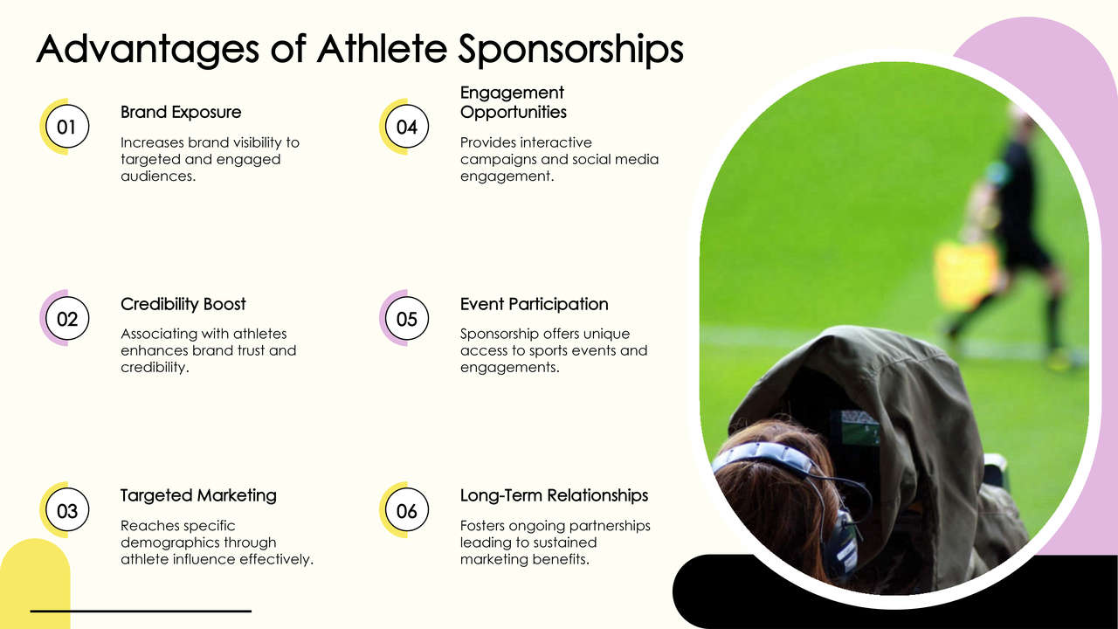

Slide 7
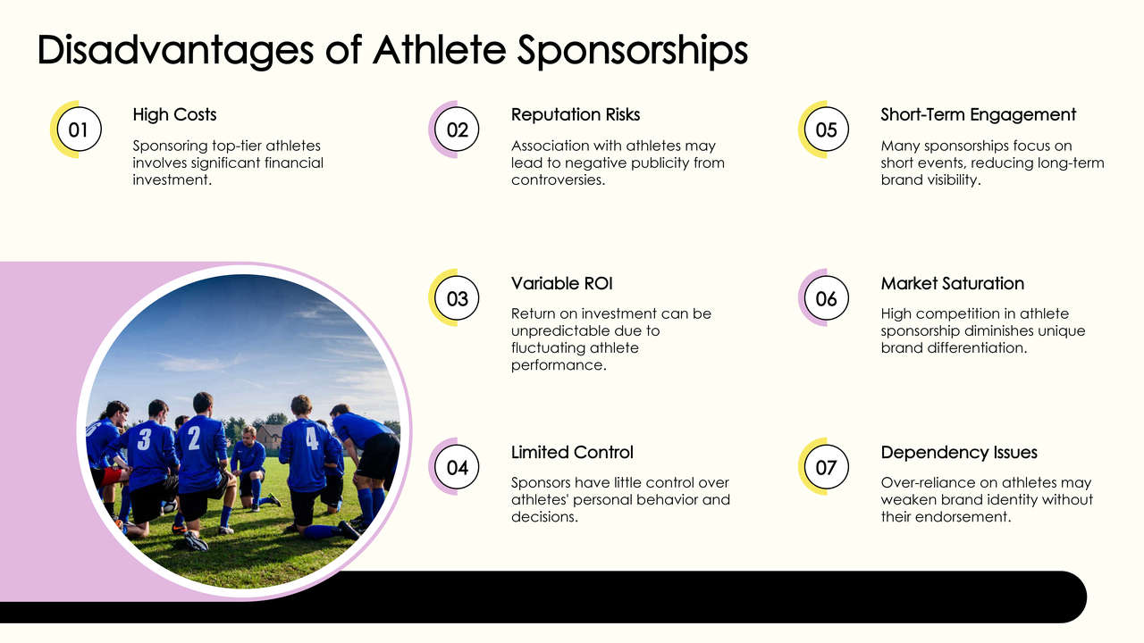

Slide 8
Software Requirements:
Python 3.12(64-bits)
Visual Studio Code
Hardware Requirements:
Processor : Intel i5
Ram : 16GB
Hard Disk :500GB

Slide 9
Athlete sponsorship managers can benefit from a variety of benefits, including:
Brand awareness: Sponsorships can help businesses build brand awareness and create positive associations with a sport or team.
Targeted marketing: Brands can reach specific demographics by sponsoring the right athlete or sports event.
Increased sales: Sponsorships can help generate leads and sales.
Customer loyalty: Sponsorships can help build loyalty among customers and employees.
New markets: Sponsorships can help businesses reach new markets and demographics.

Slide 10
CONCLUSION:
Career opportunities:
Sports sponsorship management can be a fast-paced, creative, and growth-oriented career, whether working with emerging athletes or top sports organizations.
Brand image:
Athlete sponsorship can help brands increase awareness and shape their image by creating positive associations with the athlete.
Marketing strategy:
Sports sponsorship can be an effective marketing strategy for brands to connect with consumers, expand their reach, and enhance their brand image

Slide 11
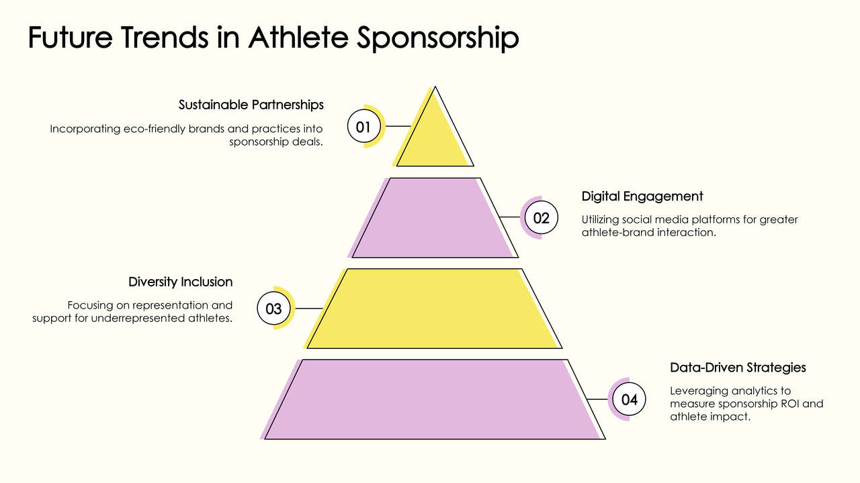

Slide 12
Reference Books & Resources:
“The Sponsorship Handbook” by Pippa Collett and William Fenton: Offers in-depth insight into creating effective sponsorship deals and managing them.
“Sports Marketing: A Strategic Perspective” by Matthew D. Shank: Covers sports marketing principles, including sponsorship management.
“Athlete Endorsements and Sponsorship: From Theory to Practice” by Nicholas Burton: Focuses on the complexities of athlete sponsorship from both the athlete and brand perspectives.
Tools used often include CRM systems for deal tracking and social media analytics platforms.

Slide 13
Thank you.
From team no:22

